Slide 1
Chapter 6 Container Orchestration with Kubernetes

Slide 2
Learning Topics
Overview of Kubernetes
Kubernetes Architecture
Key Components
Deploy Dockerized Apps
Monitoring Kubernetes

Slide 3
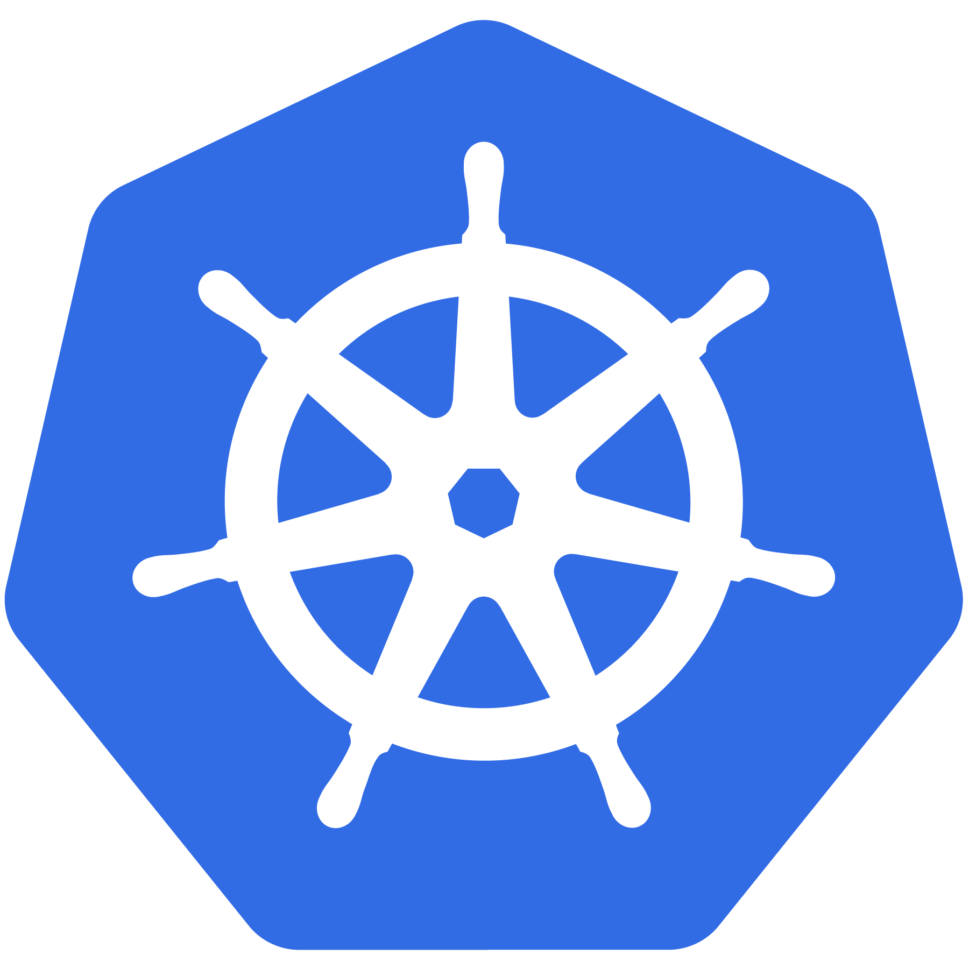
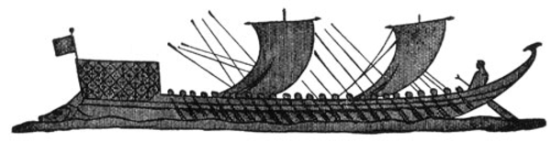
Kubernetes Meaning
Greek for “pilot” or
“Helmsman of a ship”

Slide 4
K8s History
Project that was spun out of Google as an open source container orchestration platform.
Built from the lessons learned in the experiences of developing and running Google’s Borg and Omega.
Designed from the ground-up as a loosely coupled collection of components centered around deploying, maintaining and scaling workloads.

Slide 5
K8s History
Contributors include Google, CodeOS, Redhat, Mesosphere, Microsoft, HP, IBM, VMWare, Pivotal, SaltStack etc.
Kubernetes is loosely coupled, meaning that all the components have little knowledge of each other and function independently.
This makes them easy to replace and integrate with a wide variety of systems
Written in Go Language

Slide 6

Who Manages Kubernetes
Sub-Foundation of Linux Foundation
A Vendor Neutral Entity to Manage “Cloud Native” Projects
Focused on
Containers
Dynamic Orchestration
Many More Services

Slide 7
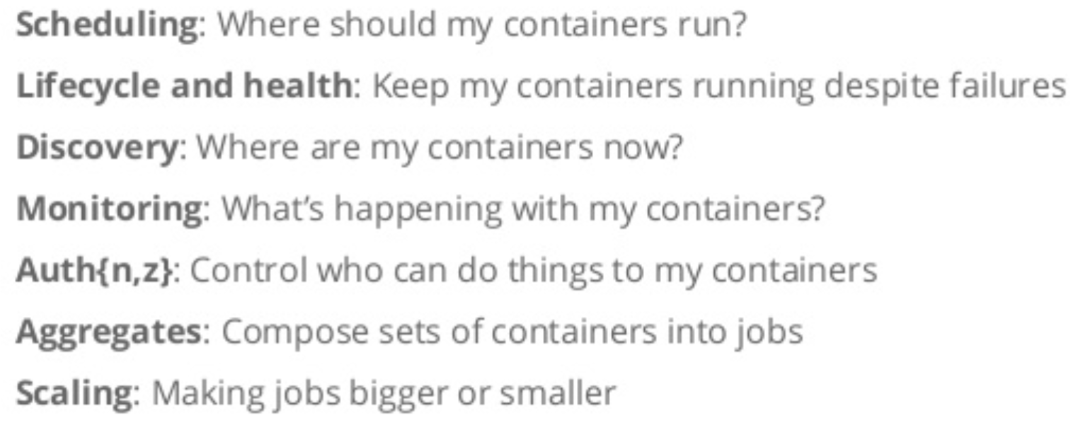
Container Issues

Slide 8
What Does Kubernetes Do?
Groups containers that make up an application into logical units for easy management and discovery
It acts as an engine for resolving state by converging actual and the desired state of the system
It is declarative, you tell it what you want it to be, and it figures it out
e.g. ‘I want 3 instances of x’ and it just does it, if something dies, it brings it back to get to 3

Slide 9
Most Popular Use Cases
Autoscale Workloads
Blue/Green Deployments
Scheduled Cronjobs
Manage Stateless Applications
Easily Integrate and Support 3rd Party Apps
Provide Native Methods of Service Discovery

Slide 10
Kubernetes Features
Kubernetes is an open-source system for
Automating Deployment
Scaling
Management
of containerized applications
Kubernetes can scale without increasing your ops team

Slide 11
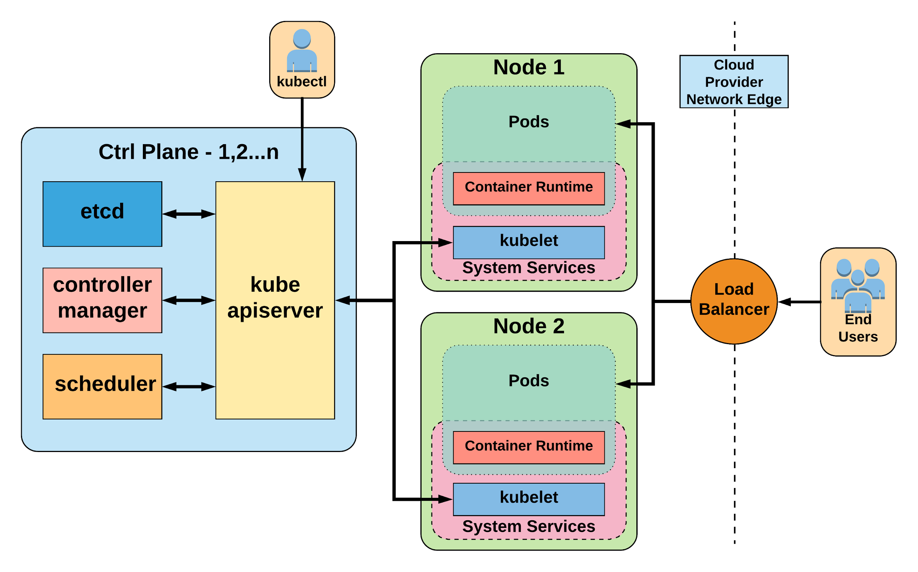
Kubernetes Architecture

Slide 12
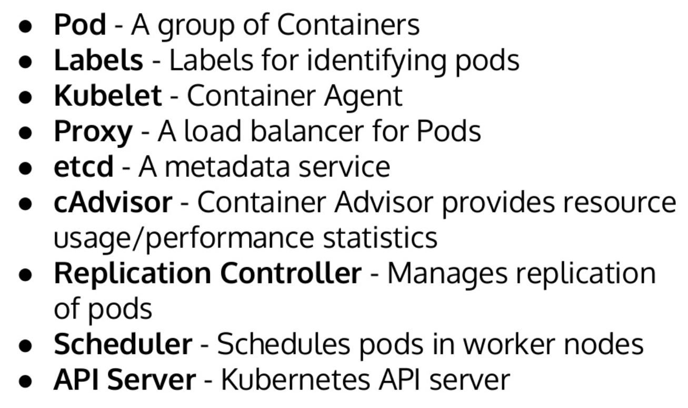
Key Terminologies

Slide 13
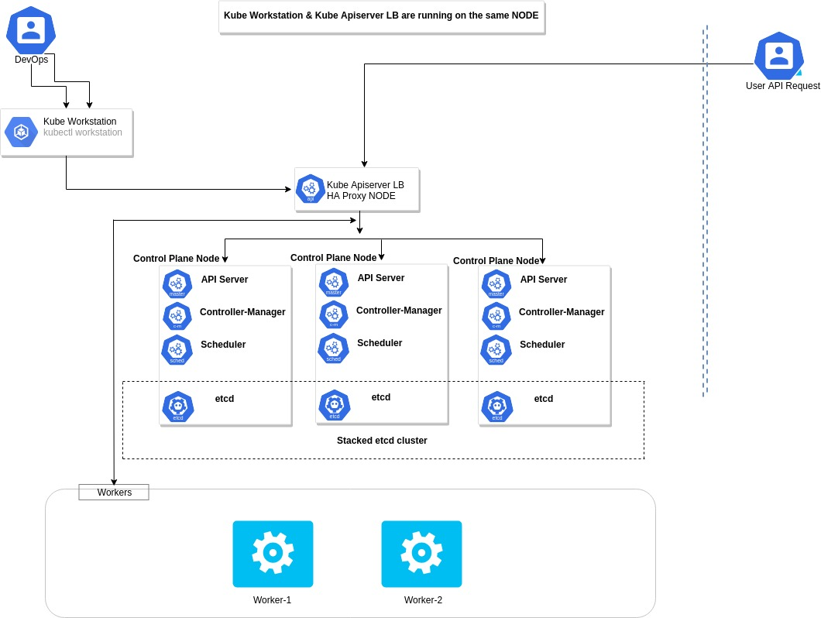
HA Cluster Architecture

Slide 14
Pods
Smallest Unit of Work
Collection of One or More Containers
Share Volumes, Network Namespace
Part of Single Context, Managed Together
Ephemeral in Nature

Slide 15
Deployments

Slide 16
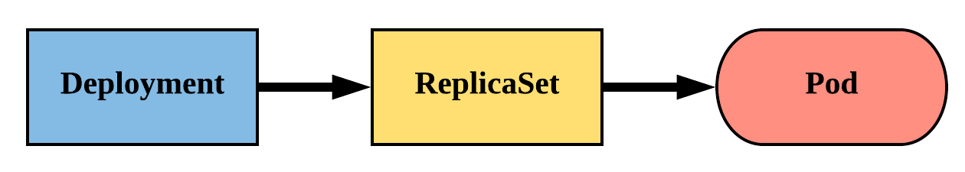
Deployments
Declarative method of managing Pods via ReplicaSets
Provides rollback functionality and update control
Updates are managed through the pod-template-hash label
Each iteration creates a unique label that is assigned to both the ReplicaSet and subsequent Pods

Slide 17
Lab 1 – Deploy App on K8 Cluster

Slide 18
Lab 2 – Deploy Java App on K8 Cluster
Use your Java app image from Docker lab

Slide 19
Lab 3 – Deploy .NET App on K8 Cluster
Use your .NET app image from Docker lab

Slide 20
Lab 4 – Deploy Python App on K8 Cluster
Use your Python app image from Docker lab

Slide 21
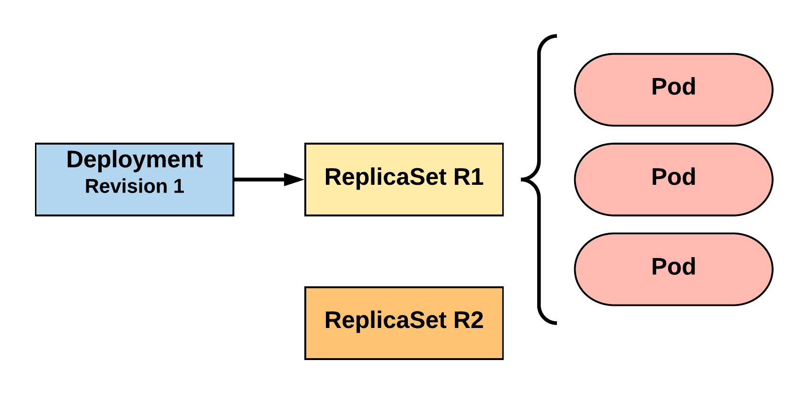
RollingUpdate Deployment
Updating pod template generates a new ReplicaSet revision.
R1 pod-template-hash: 676677fff
R2 pod-template-hash: 54f7ff7d6d
$ kubectl get replicaset
NAME DESIRED CURRENT READY AGE
mydep-6766777fff 3 3 3 5h
$ kubectl get pods
NAME READY STATUS RESTARTS AGE
mydep-6766777fff-9r2zn 1/1 Running 0 5h
mydep-6766777fff-hsfz9 1/1 Running 0 5h
mydep-6766777fff-sjxhf 1/1 Running 0 5h
Notes:
We add a new label, change the image, do something to change the pod template in some way
The deployment controller creates a new replicaset with 0 instances to start

Slide 22
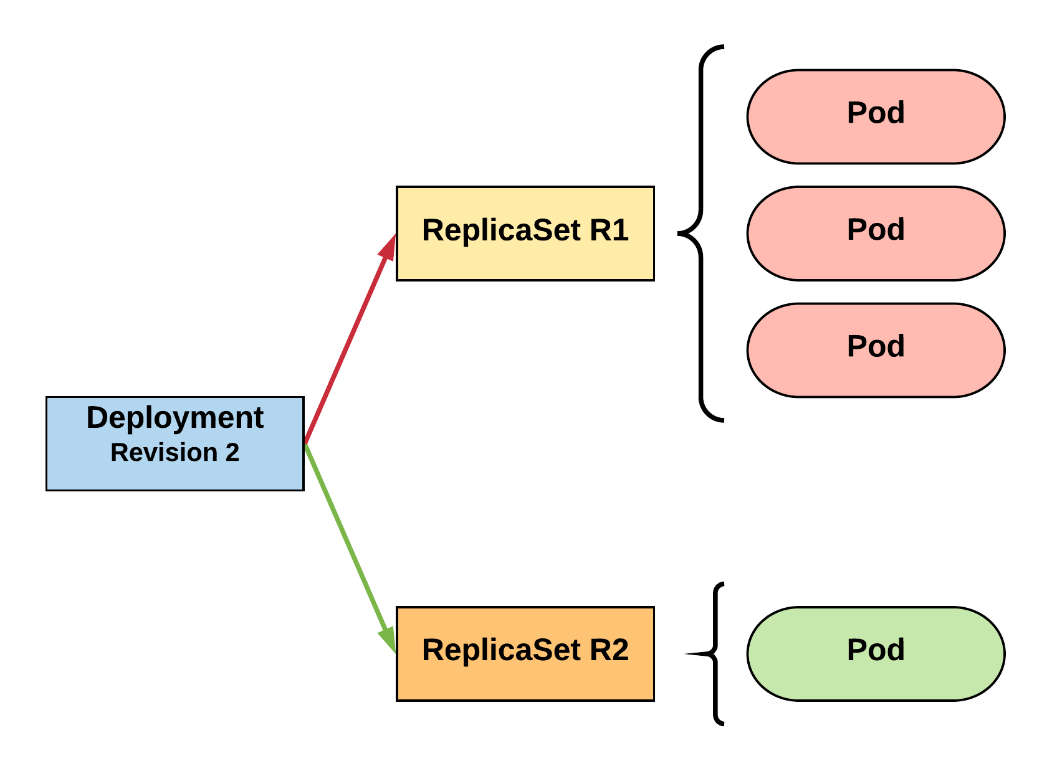
RollingUpdate Deployment
New ReplicaSet is initially scaled up based on maxSurge.
R1 pod-template-hash: 676677fff
R2 pod-template-hash: 54f7ff7d6d
$ kubectl get replicaset
NAME DESIRED CURRENT READY AGE mydep-54f7ff7d6d 1 1 1 5s
mydep-6766777fff 2 3 3 5h
$ kubectl get pods
NAME READY STATUS RESTARTS AGE
mydep-54f7ff7d6d-9gvll 1/1 Running 0 2s
mydep-6766777fff-9r2zn 1/1 Running 0 5h
mydep-6766777fff-hsfz9 1/1 Running 0 5h
mydep-6766777fff-sjxhf 1/1 Running 0 5h
Notes:
It then scales up the new ReplicaSet based on our maxSurge value

Slide 23
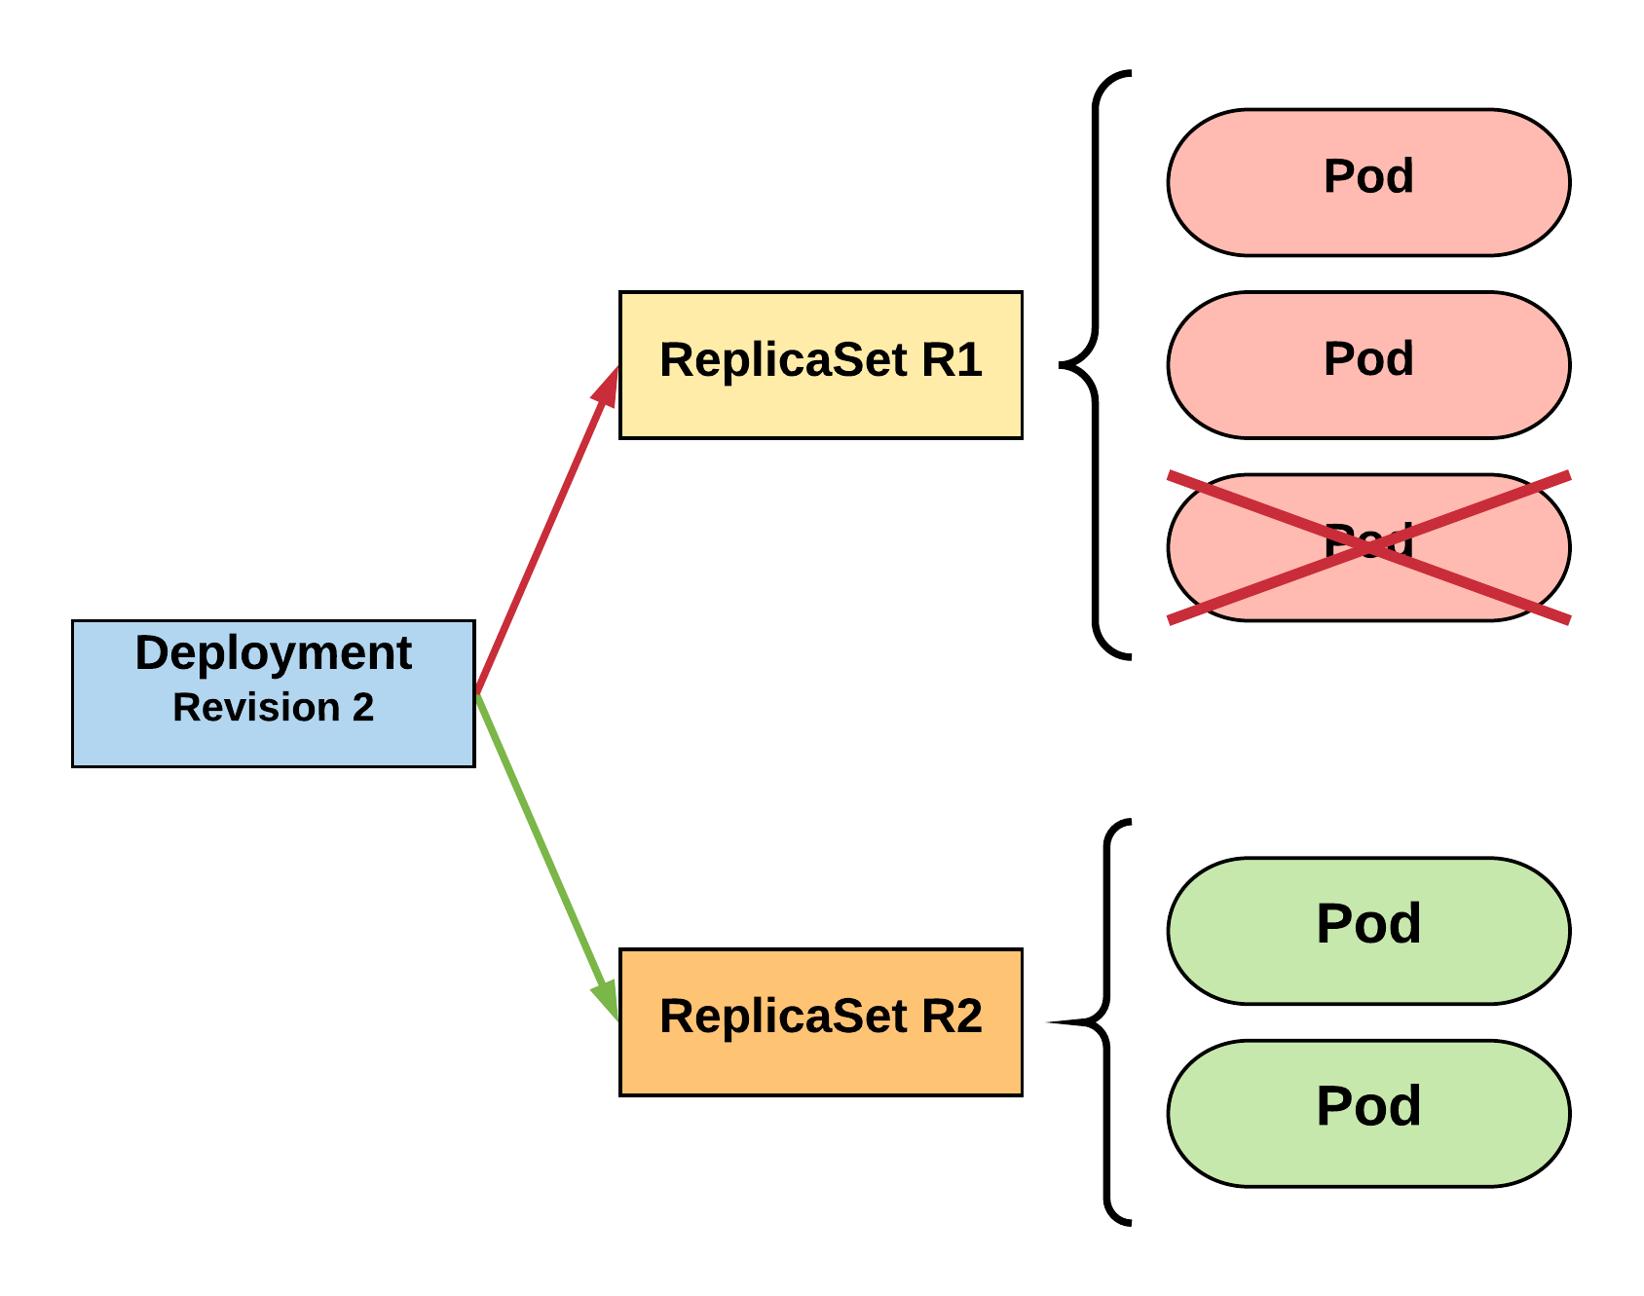
RollingUpdate Deployment
Phase out of old Pods managed by maxSurge and maxUnavailable.
R1 pod-template-hash: 676677fff
R2 pod-template-hash: 54f7ff7d6d
$ kubectl get replicaset
NAME DESIRED CURRENT READY AGE mydep-54f7ff7d6d 2 2 2 8s
mydep-6766777fff 2 2 2 5h
$ kubectl get pods
NAME READY STATUS RESTARTS AGE
mydep-54f7ff7d6d-9gvll 1/1 Running 0 5s
mydep-54f7ff7d6d-cqvlq 1/1 Running 0 2s
mydep-6766777fff-9r2zn 1/1 Running 0 5h
mydep-6766777fff-hsfz9 1/1 Running 0 5h
Notes:
It will then begin to kill off the prevision revision by scaling down the old replicaset and scaling up the new one

Slide 24
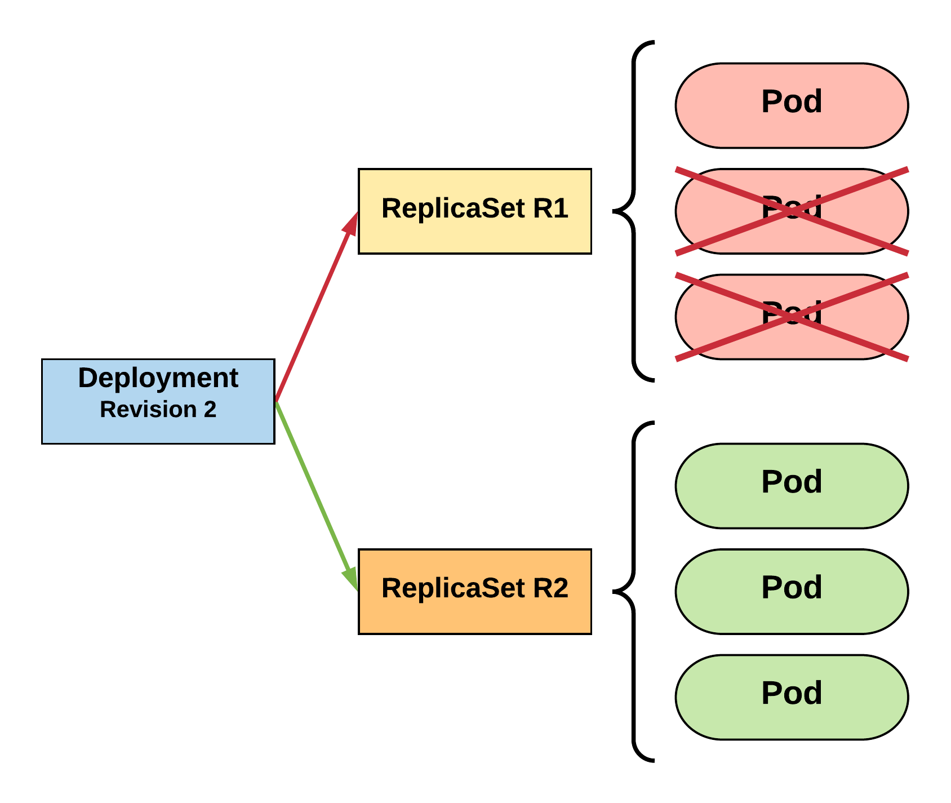
RollingUpdate Deployment
Phase out of old Pods managed by maxSurge and maxUnavailable.
R1 pod-template-hash: 676677fff
R2 pod-template-hash: 54f7ff7d6d
$ kubectl get replicaset
NAME DESIRED CURRENT READY AGE mydep-54f7ff7d6d 3 3 3 10s
mydep-6766777fff 0 1 1 5h
$ kubectl get pods
NAME READY STATUS RESTARTS AGE
mydep-54f7ff7d6d-9gvll 1/1 Running 0 7s
mydep-54f7ff7d6d-cqvlq 1/1 Running 0 5s
mydep-54f7ff7d6d-gccr6 1/1 Running 0 2s
mydep-6766777fff-9r2zn 1/1 Running 0 5h
Notes:
Continues this pattern based on maxSurge and maxUnavailable

Slide 25
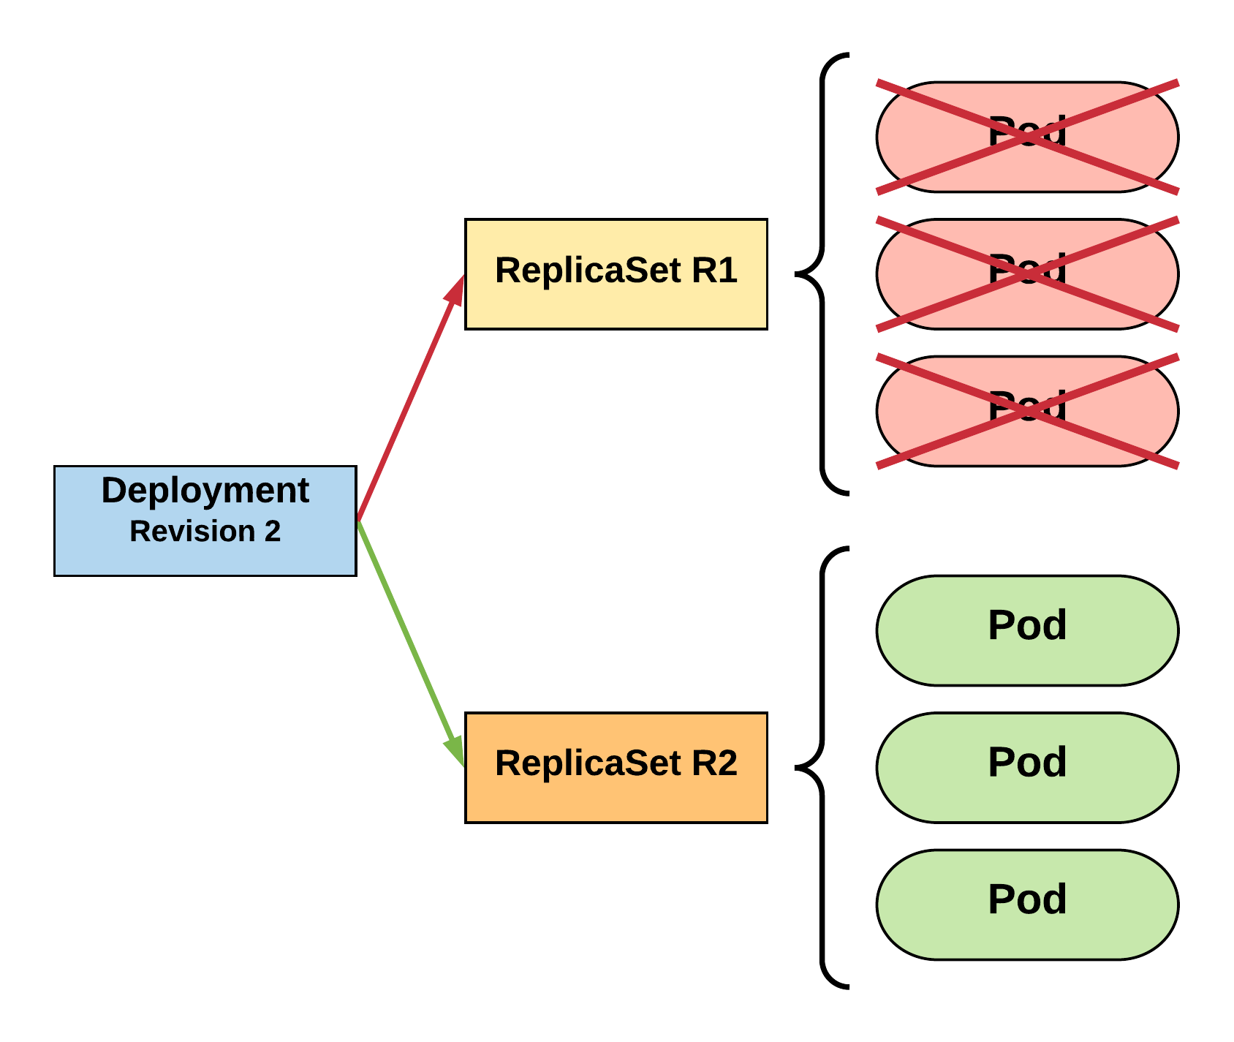
RollingUpdate Deployment
Phase out of old Pods managed by maxSurge and maxUnavailable.
R1 pod-template-hash: 676677fff
R2 pod-template-hash: 54f7ff7d6d
$ kubectl get replicaset
NAME DESIRED CURRENT READY AGE
mydep-54f7ff7d6d 3 3 3 13s mydep-6766777fff 0 0 0 5h
$ kubectl get pods
NAME READY STATUS RESTARTS AGE
mydep-54f7ff7d6d-9gvll 1/1 Running 0 10s
mydep-54f7ff7d6d-cqvlq 1/1 Running 0 8s
mydep-54f7ff7d6d-gccr6 1/1 Running 0 5s
Notes:
Update is complete

Slide 26
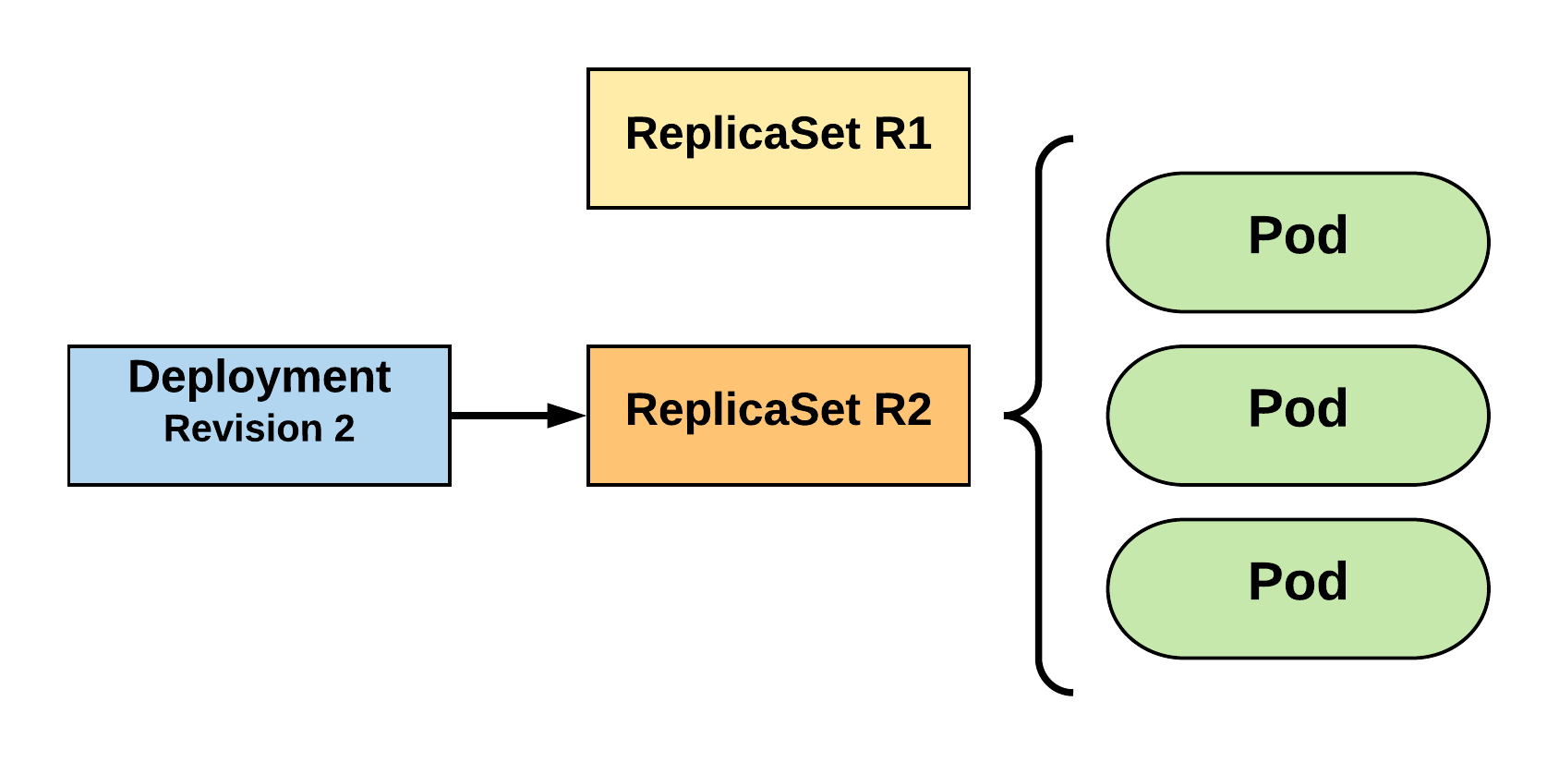
RollingUpdate Deployment
Updated to new deployment revision completed.
R1 pod-template-hash: 676677fff
R2 pod-template-hash: 54f7ff7d6d
$ kubectl get replicaset
NAME DESIRED CURRENT READY AGE mydep-54f7ff7d6d 3 3 3 15s
mydep-6766777fff 0 0 0 5h
$ kubectl get pods
NAME READY STATUS RESTARTS AGE
mydep-54f7ff7d6d-9gvll 1/1 Running 0 12s
mydep-54f7ff7d6d-cqvlq 1/1 Running 0 10s
mydep-54f7ff7d6d-gccr6 1/1 Running 0 7s
Notes:
Until the previous revision is at 0
ReplicaSet will remain around, but it will have 0 replicas. How many stay around are based off our revision history limit

Slide 27
Monitoring Kubernetes

Slide 28
Monitoring Challenges for Kubernetes
Many, smaller pieces to monitor
Keeping track of pods and containers
Health of deployed applications and containers
Availability of resources in a deployment/cluster

Slide 29
Monitoring Kubernetes – Data Sources
K8 Hosts Running Kubelet
K8 Process i.e. Kubelet Metrics : give you details on a Kubernetes node and the jobs it’s running
Metrics for apiserver
kube-scheduler
kube-controller-manager
Kubelet’s Built-in cAdvisor : collects, aggregates, processes, and exports metrics for your running containers
Kube-state Metrics : gives you information at the cluster level

Slide 30
Metrics Server
Cluster-wide aggregator of resource usage data
Metric server collects metrics from the Summary API, exposed by kubelet on each node
5000 nodes clusters with 30 pods per node, supported by kubernetes 1.6
To collect 10 metrics from each pod per node
10 x 5000 x 30 / 60 = 25000 metrics per second by average
This required a new server instead of API service, hence metrics server was created

Slide 31
Lab 5 – Monitor K8
Uses Prometheus & Grafana
Monitor Nodes
Monitor Pods
Monitor Deployments
And Much More

Slide 32
Path Forward
Start with a managed service
Docker Documentation (Docker.com)
K8 Documentation (Kuberntes.IO)
Automate Image Creation, Storage and Deployment
Create and Use Official Images Repository
Use Docker Swarm for Small Workloads
Start with Stateless Applications

Slide 33
This concludes Chapter 6 Container Orchestration with Kubernetes

